Slide 1

Schwab Intelligent Advisory
FinTech Research

Slide 2
Charles Schwab: Origin
Ranked 13th Bank and one of the largest brokerage firms in US.
Incorporated in 1971 April (renamed to Charles Schwab in 1973)
In 1975, when the SEC mandates negotiated commission rates for all securities transactions, Chuck created a new kind of brokerage - a discount brokerage.
Continuous innovation (on how products and services are delivered).
Notes:
Starting with no name, then captured an opportunity.
Long-term principle - low cost. (Southwest airline?)
On Continuous innovation: Beta Mainframe, Schwab quotes, Telebroker, cloud, mobile… and then Schwab Intelligent Advisory)

Slide 3
Schwab Intelligent Advisory: History
2015: Schwab Intelligent Portfolios, through Schwab Wealth Investment Advisory, Inc.
2016: New features and enhancements to Institutional Intelligent Portfolios; Schwab Intelligent Advisory for consumers.
2017: Schwab Intelligent Advisory, broadly available, making it one of the most accessible and lowest-cost advisory solutions available to investors.
2019: A new subscription pricing model for Schwab Intelligent Advisory and renames the service Schwab Intelligent Portfolios Premium™. Schwab makes an industry-leading move, reducing U.S. stock, ETF and options online trade commissions from $4.95 to $0.
Notes:
Schwab Intelligent Portfolios uses sophisticated computer algorithms to build, monitor, and rebalance diversified portfolios based on an investor's stated goals. Then Schwab announced launch of Institutional Intelligent Portfolios.

Slide 4
Charles Schwab on Charles Schwab
Make things easier, better, more successful for the individual investor.
Minimize the friction, the cost of investing. It is gotta be reduced to near zero.
Help younger people gain financial knowledge and engage in their financial life early.
Changing the way Americans invest.

Slide 5
Robo-advisors
Implement through Schwab Intelligent Advisory;
Digital platform to provide automated, algorithm-driven financial planning services;
Little or no human supervision;
Collects information from clients through survey;
Offer advice and invest client assets;
Tax-loss harvesting, investment selection, retirement planning, account rebalancing.

Slide 6
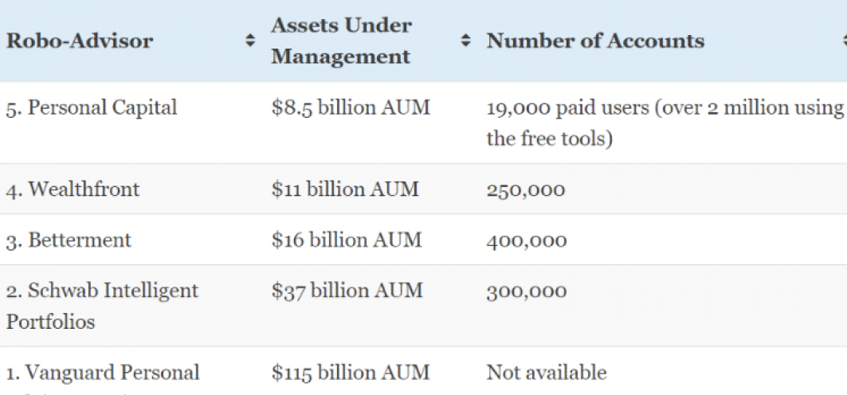
Competitors
Notes:
Though small companies have new technology, Schwab has its advantage in customer base and data abundance.

Slide 7
Recommendation
More than focusing on efficiency (replacing human);
Personalization
Financial hub (various financial products, such as payment, loans…)
Network effect (online community?)
Notes:
Schwab Intelligent Portfolios uses sophisticated computer algorithms to build, monitor, and rebalance diversified portfolios based on an investor's stated goals. Then Schwab announced launch of Institutional Intelligent Portfolios.

